Slide 1


Special Relativity Calculations 3 This doesn't add up!

Slide 2

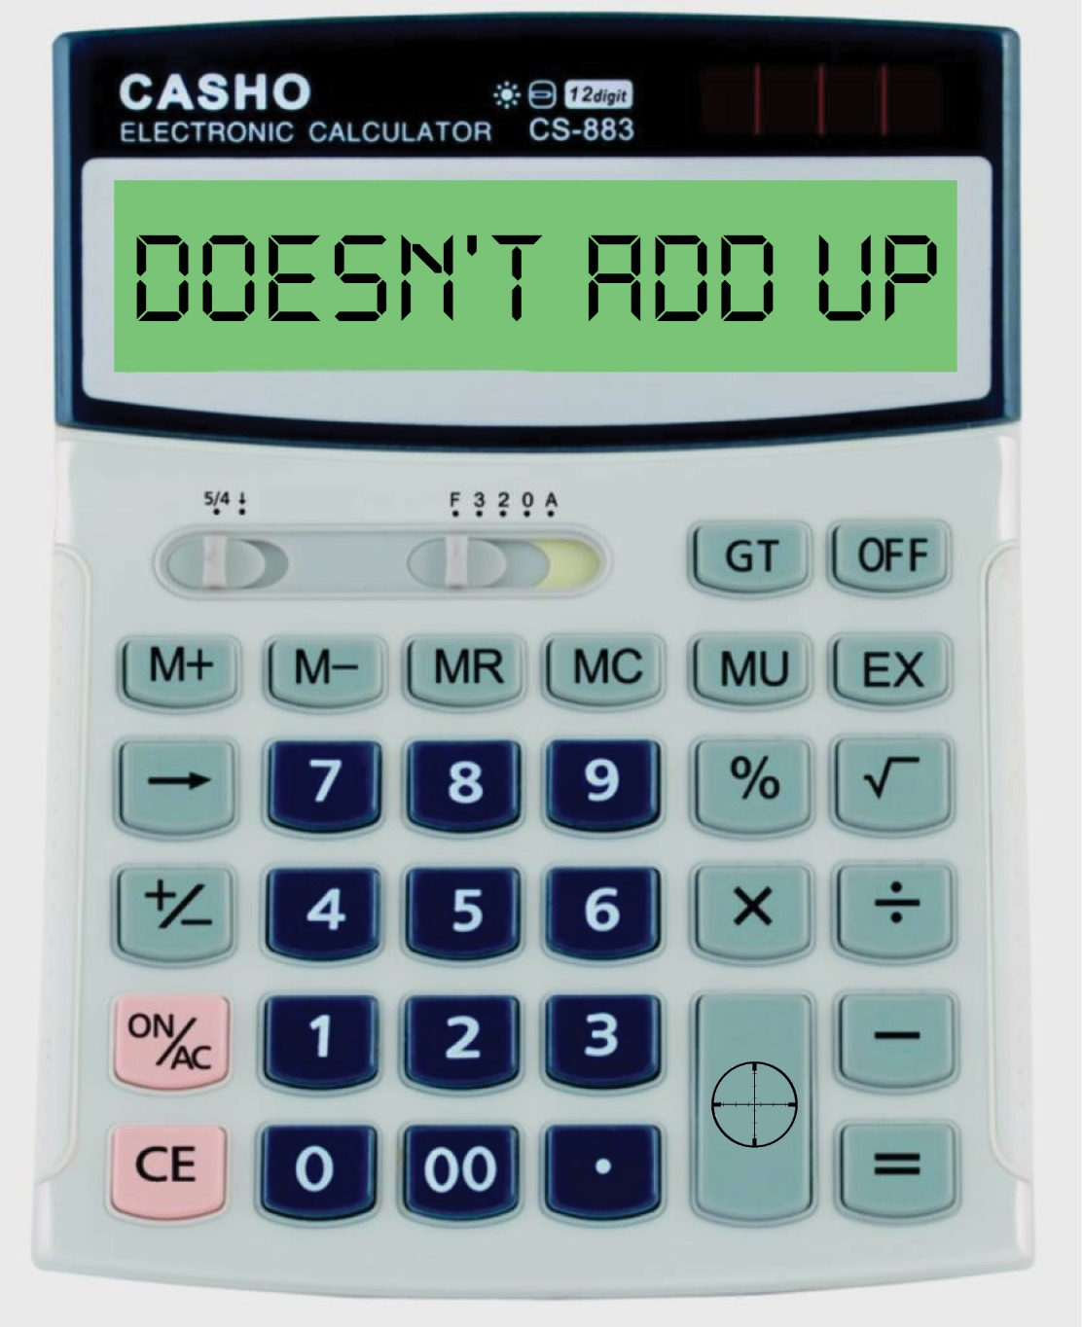
Special Relativity Review
Time Dilation Review
Length Contraction Review
Relativistic Velocity Addition

Slide 3
All Motion is Relative – To your frame of reference

Slide 4
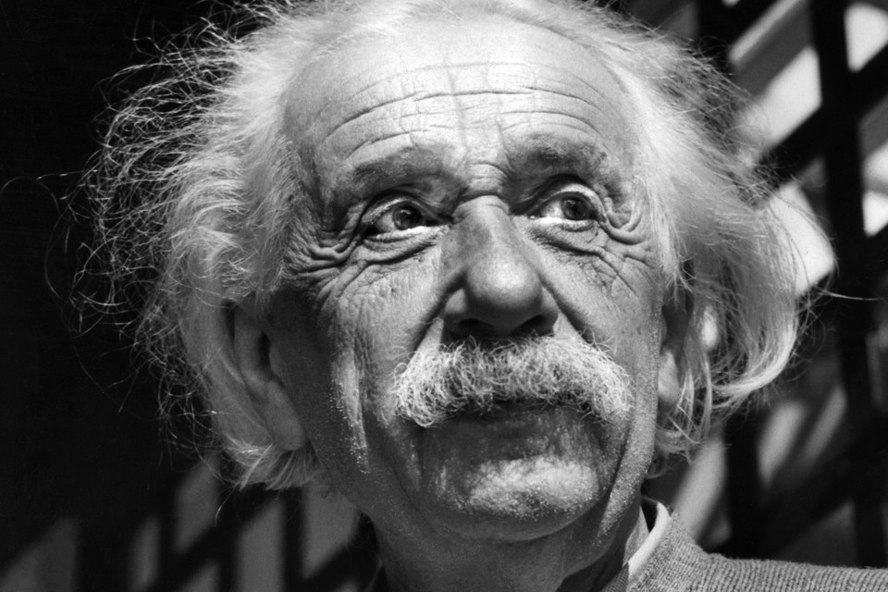
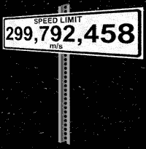
Two Postulates of Special Relativity
Einstein’s Special Theory of Relativity, published in 1905, was based on two postulates:
I. The laws of physics are the same for all frames of reference moving at a constant velocity with respect to each other.
II. The velocity of light in a vacuum c is constant for all observers, independent of their state of motion. (c = 3.00 x 10⁸ ms⁻¹)

Slide 5
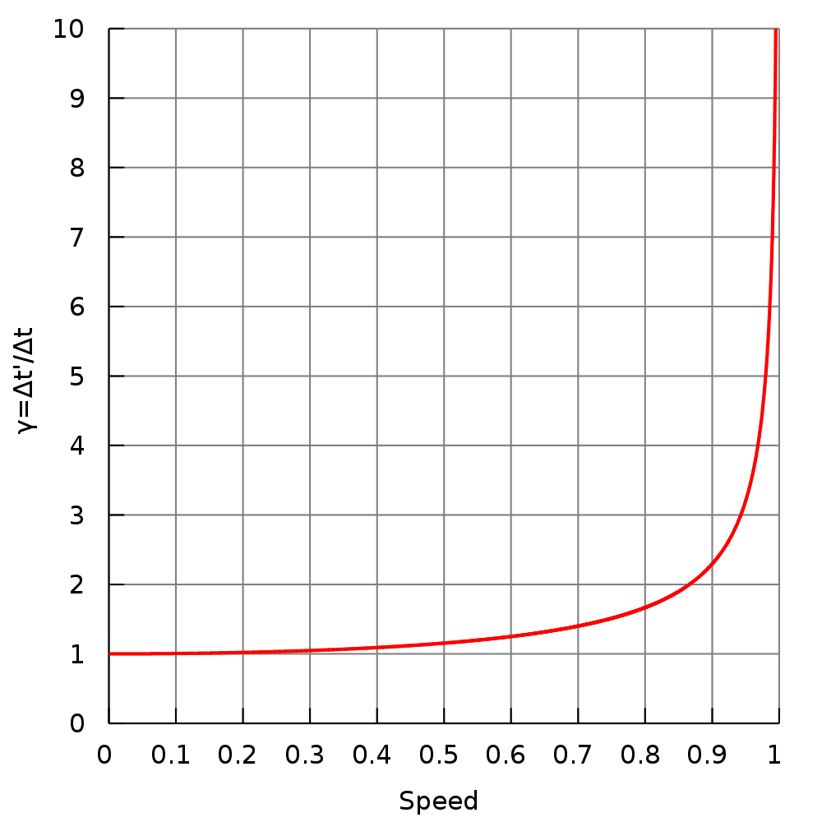
Time Dilation Review
Time measured for an event in a moving frame will be greater than the actual time for the event inside that frame, if measured from a reference outside the moving frame of reference.
In other words, time appears to go slower inside a moving frame when viewed from outside that frame.

Slide 6

Length and Distance Contraction
One of the other effects of relativistic speeds is that lengths are shorter when measured from a different inertial reference frame.
We call this length contraction.

Slide 7
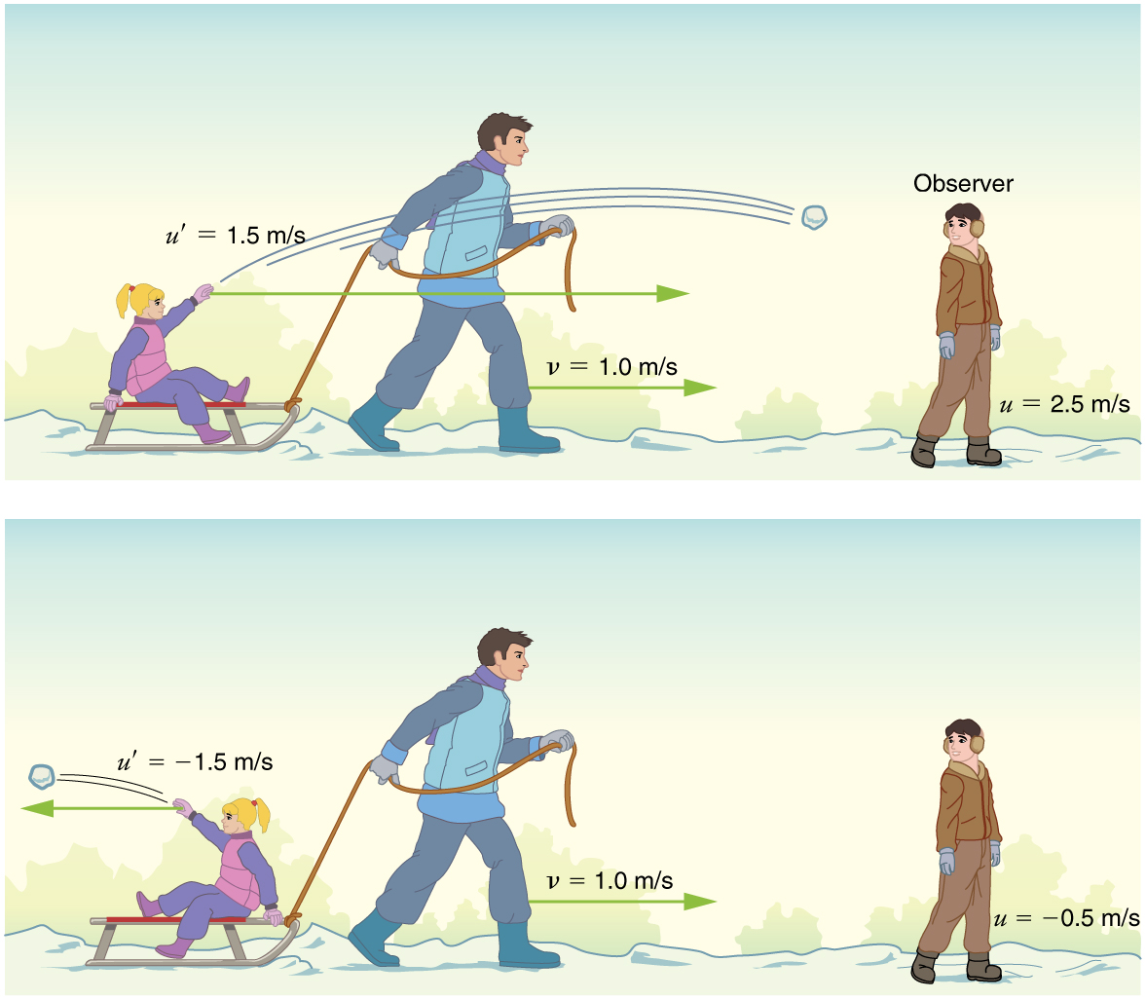
Addition of Velocities
In normal circumstances, if you are moving and throw an object, an outside observer will see the object at a different velocity.
Straight-forward velocity addition.
u=v+u′
u = velocity relative to observer not in moving reference frame.
v = velocity of moving reference frame relative to observer.
u′ = second velocity relative to moving frame

Slide 8
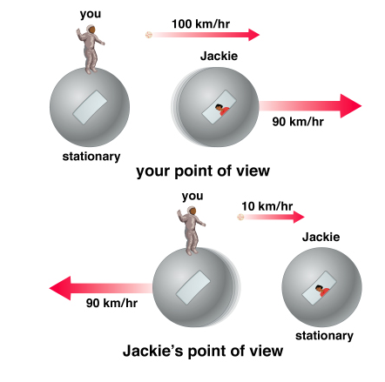
Addition of Velocities

Slide 9
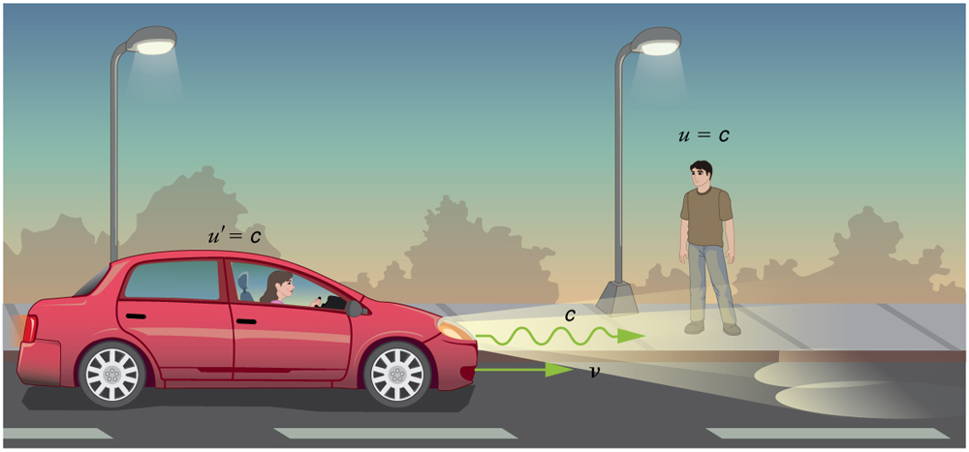
Addition of Velocities
Einstein's 2nd postulate tells us that all observers agree on the speed of light.
Imagine a car traveling at night along a straight road. If classical velocity addition applied to light, then the light from the car’s headlights would approach the observer on the sidewalk at a speed u=v+c
But we know that light will move away from the car at speed c relative to the driver of the car, and light will move towards the observer on the sidewalk at speed c too.

Slide 10
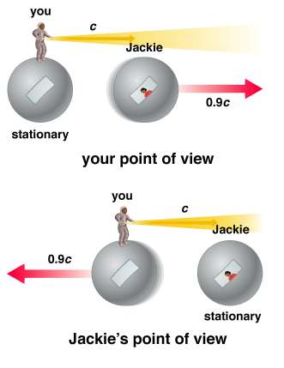
Addition of Velocities
Einstein's 2nd postulate tells us that all observers agree on the speed of light.
Jackie will agree that the light is traveling at c, no matter which direction you are traveling in or how fast.

Slide 11
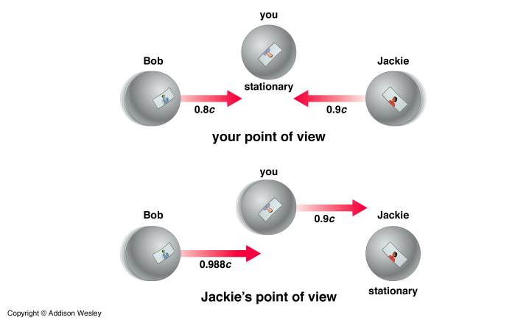
Addition of Velocities
What about objects?
Imagine the situation where Bob and Jackie are both flying towards you at 0.8c and 0.9c respectively.
You can see them, so they must be going slower than light.
But what about Jackie when she is looking at Bob? How fast does she see him moving?
0.8c? 1.7c?
Einstein showed that speeds above c were not possible so the latter cant be correct. Jackie can also see Bob, so light from him must be moving faster than his ship.
Jackie sees you moving towards her at 0.9c (relative motion), so Bob must be going faster than that because he is closing on you.
To solve this type of problem, Einstein came up with a way to add relativistic velocities.
The relative velocity between two objects never exceeds the speed of light!

Slide 12
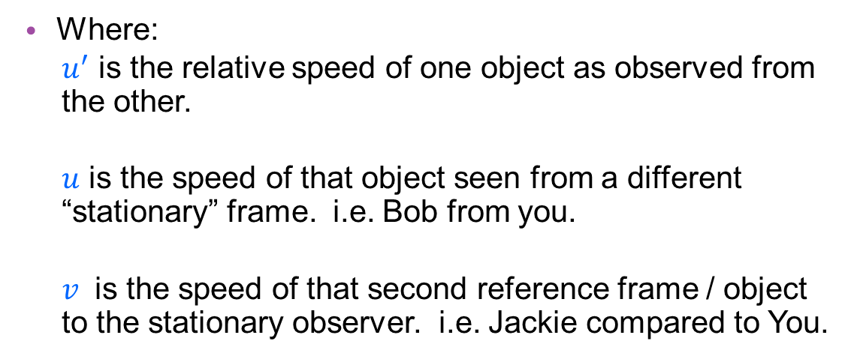
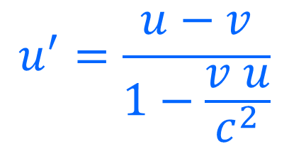
Relativistic Relative Velocities
Two objects compared
$$u^{′}=\frac{u−v}{1−\frac{v u}{c^{2}}}$$
Where:
$u^{′}$ is the relative speed of one object as observed from the other.
$u$ is the speed of that object seen from a different “stationary” frame. i.e. Bob from you.
$v$ is the speed of that second reference frame / object to the stationary observer. i.e. Jackie compared to You.
Directions matter!

Slide 13
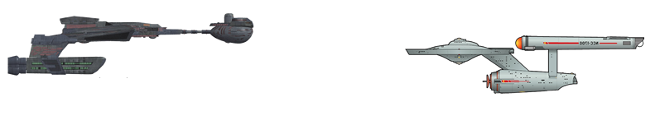

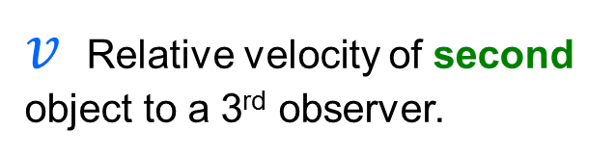
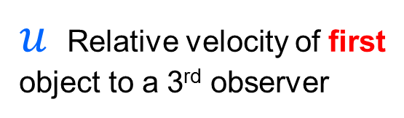
Working out which variable is which…
$u^{′}$ Relative velocity of first object compared to the second
$v$ Relative velocity of second object to a 3rd observer.
$u$ Relative velocity of first object to a 3rd observer

Slide 14
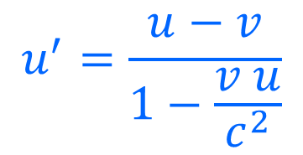
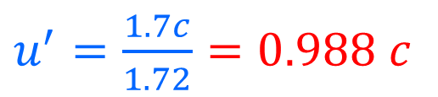
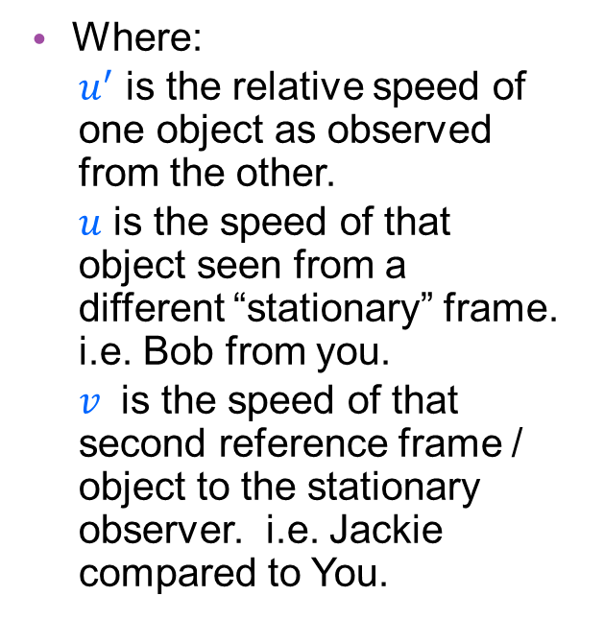
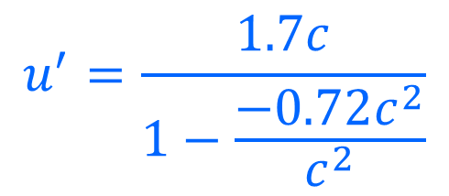
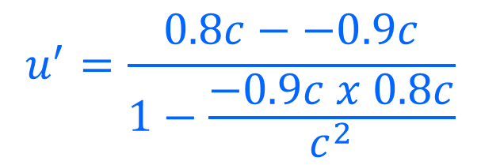
Relativistic Relative Velocities
Two objects compared
Where:
$u^{′}$ is the relative speed of one object as observed from the other.
$u$ is the speed of that object seen from a different “stationary” frame. i.e. Bob from you.
$v$ is the speed of that second reference frame / object to the stationary observer. i.e. Jackie compared to You.
$$u^{′}=\frac{u−v}{1−\frac{v u}{c^{2}}}$$
$$u^{′}=\frac{0.8c−−0.9c}{1−\frac{−0.9c x 0.8c}{c^{2}}}$$
$$u^{′}=\frac{1.7c}{1−\frac{−0.72c^{2}}{c^{2}}}$$
$u^{′}=\frac{1.7c}{1.72}=0.988 c$

Slide 15
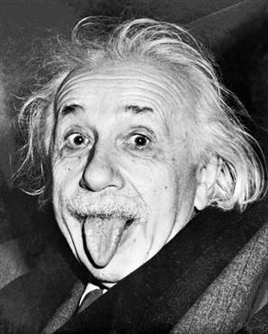
Two things are infinite: the universe and human stupidity; and I'm not sure about the universe.

Slide 16
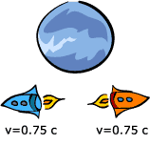

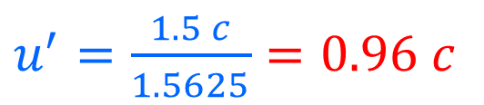

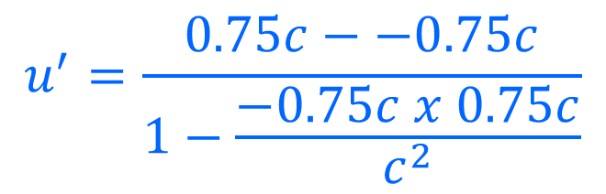
Relativistic Velocity Additions
Two objects compared
If two spacecraft are moving at 0.75c in opposite directions from the planet as shown.
What velocity do they see each other moving away at?
$$u^{′}=\frac{1.5c}{1−\frac{−0.5625c^{2}}{c^{2}}}$$
$$u^{′}=\frac{u−v}{1−\frac{v u}{c^{2}}}$$
$$u^{′}=\frac{0.75c−−0.75c}{1−\frac{−0.75c x 0.75c}{c^{2}}}$$
$u^{′}=\frac{1.5 c}{1.5625}=0.96 c$

Slide 17
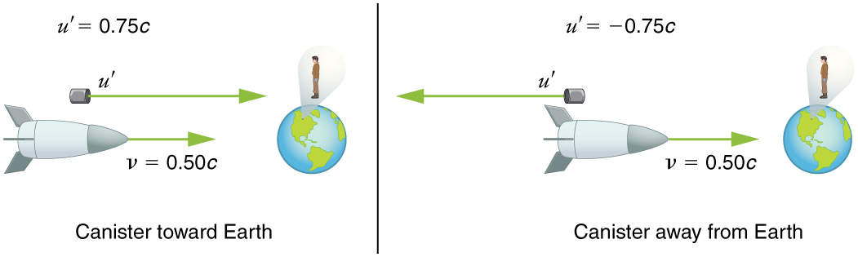
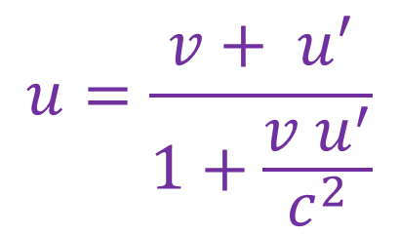
Relativistic Relative Velocities
Projectiles
$$u=\frac{v+ u^{′}}{1+\frac{v u^{′}}{c^{2}}}$$
Where:
$u^{′}$ is the relative speed of one object as observed from the other.
$u$ is the speed of that object seen from a different “stationary” frame. i.e. Bob from you.
$v$ is the speed of that second reference frame / object to the stationary observer. i.e. Jackie compared to You.
Directions matter!

Slide 18
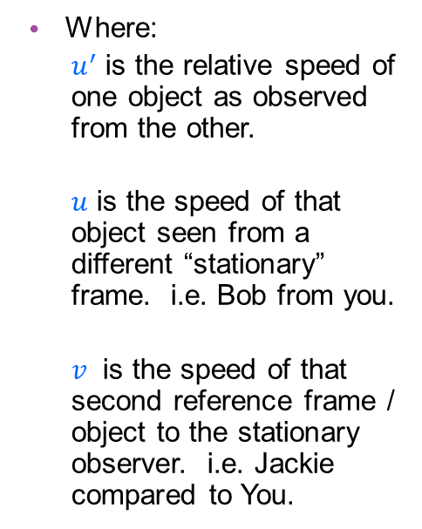
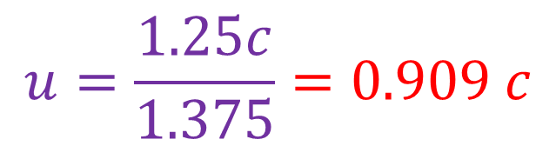
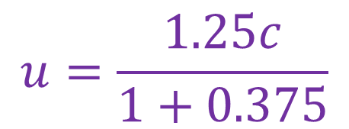
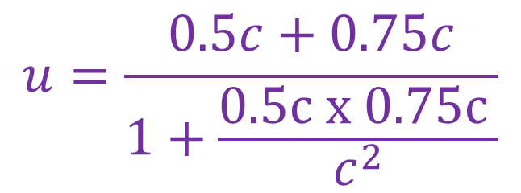
Relativistic Relative Velocities
Projectiles
Where:
$u^{′}$ is the relative speed of one object as observed from the other.
$u$ is the speed of that object seen from a different “stationary” frame. i.e. Bob from you.
$v$ is the speed of that second reference frame / object to the stationary observer. i.e. Jackie compared to You.
$$u=\frac{v+ u^{′}}{1+\frac{v u^{′}}{c^{2}}}$$
What velocity does the observer measure for the incoming missile?
$$u=\frac{0.5c+0.75c}{1+\frac{0.5c x 0.75c }{c^{2}}}$$
$$u=\frac{1.25c}{1+0.375}$$
$$u=\frac{1.25c}{1.375}=0.909 c$$

Slide 19
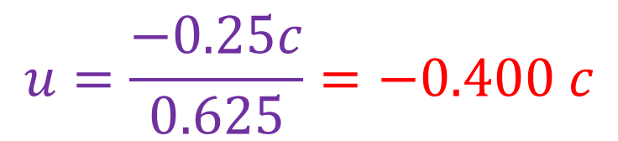
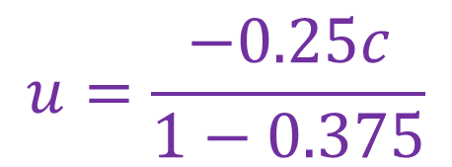
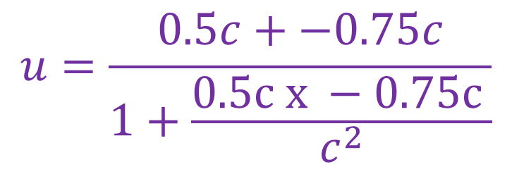
Relativistic Relative Velocities
Projectiles
Where:
$u^{′}$ is the relative speed of one object as observed from the other.
$u$ is the speed of that object seen from a different “stationary” frame. i.e. Bob from you.
$v$ is the speed of that second reference frame / object to the stationary observer. i.e. Jackie compared to You.
$$u=\frac{v+ u^{′}}{1+\frac{v u^{′}}{c^{2}}}$$
What velocity does the observer measure for the retreating missile?
$$u=\frac{0.5c+−0.75c}{1+\frac{0.5c x −0.75c }{c^{2}}}$$
$$u=\frac{−0.25c}{1−0.375}$$
$$u=\frac{−0.25c}{0.625}=−0.400 c$$

Slide 20
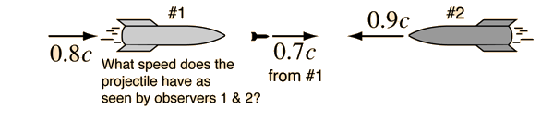
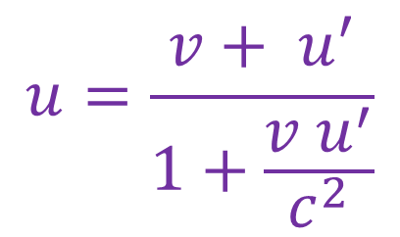
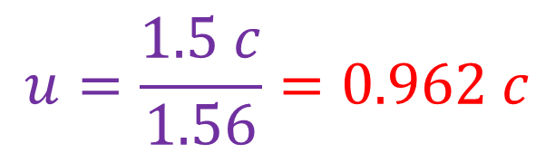
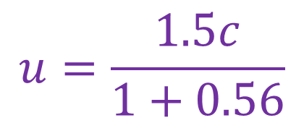
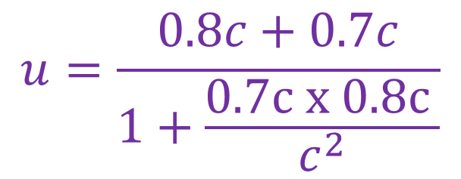
Relativistic Relative Velocities
Projectiles
$$u=\frac{v+ u^{′}}{1+\frac{v u^{′}}{c^{2}}}$$
An observer on a small asteroid between two incoming starships sees them approaching as shown above. Ship #1 fires at Ship #2 with a missile which Ship #1 measures moving away at 0.7c.
What velocity does the central observer see the missile approaching at?
What velocity does the captain of Ship #2 see Ship #1 approaching at?
What velocity does the same captain see the missile from Ship #1 approaching at?
$$u=\frac{0.8c+0.7c}{1+\frac{0.7c x 0.8c }{c^{2}}}$$
$$u=\frac{1.5c}{1+0.56}$$
$$u=\frac{1.5 c}{1.56}=0.962 c$$

Slide 21
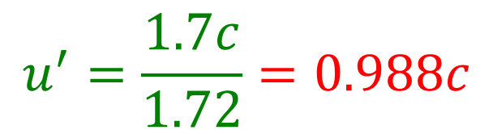
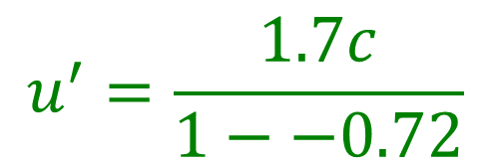
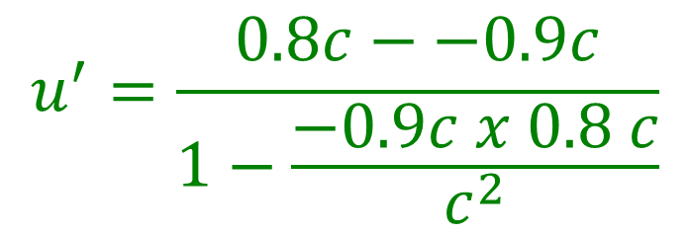
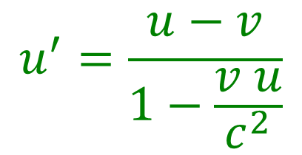
Relativistic Relative Velocities
Projectiles
$$u^{′}=\frac{u−v}{1−\frac{v u}{c^{2}}}$$
An observer on a small asteroid between two incoming starships sees them approaching as shown above. Ship #1 fires at Ship #2 with a missile which it measures moving away at 0.7c.
What velocity does the central observer see the missile approaching at?
What velocity does the captain of Ship #2 see Ship #1 approaching at?
What velocity does the same captain see the missile from Ship #1 approaching at?
$$u^{′}=\frac{0.8c−−0.9c}{1−\frac{−0.9c x 0.8 c}{c^{2}}}$$
$$u^{′}=\frac{1.7c}{1−−0.72}$$
$$u^{′}=\frac{1.7c}{1.72}=0.988c$$

Slide 22
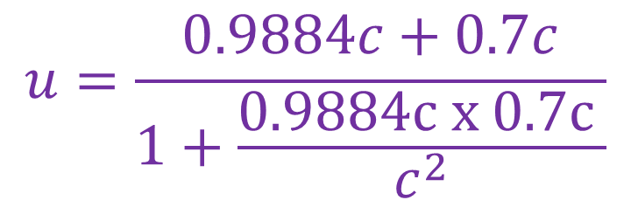
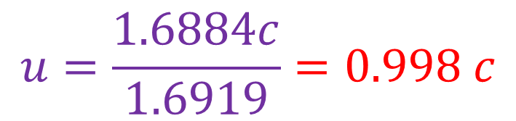
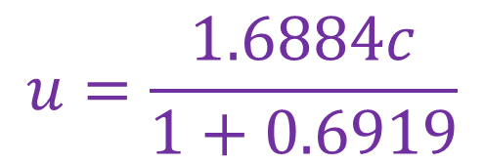
Relativistic Relative Velocities
Projectiles
$$u=\frac{v+ u^{′}}{1+\frac{v u^{′}}{c^{2}}}$$
An observer on a small asteroid between two incoming starships sees them approaching as shown above. Ship #1 fires at Ship #2 with a missile which it measures moving away at 0.7c.
What velocity does the central observer see the missile approaching at?
What velocity does the captain of Ship #2 see Ship #1 approaching at?
What velocity does the same captain see the missile from Ship #1 approaching at?
$$u=\frac{0.9884c+0.7c}{1+\frac{0.9884c x 0.7c }{c^{2}}}$$
$$u=\frac{1.6884c}{1+0.6919}$$
$$u=\frac{1.6884c}{1.6919}=0.998 c$$

Slide 23
2016 Physics Sample Exam Question
A group of astronauts is sent on a mission to collect data about an exoplanet that could possibly sustain human life. The spacecraft travels at a constant speed of 0.850c. Two identical clocks that have been synchronised carefully on the Earth are to be used during the mission. One clock is left with an observer on Earth and the other is placed on the spacecraft. In the Earth’s frame of reference, the clocks are observed to tick once every second.
A rocket probe is launched from the spacecraft. The rocket probe moves at 0.500c relative to the spacecraft.
To an observer in the Earth’s frame of reference, what would be the speed of the rocket probe in terms of the speed of light? (2 marks)

